Slide 1





















SHRI G. S. INSTITUTE OF TECHNOLOGY AND SCIENCE
INTRODUCTION TO HTML AND HTML5
SUBMITTED TO:
ASST. PROF. UPENDRA SINGH
ASST. PROF. SHWETA GUPTA
ADARSH AGRAWAL
SUBMITTED BY:
0801IT221150

Slide 2
DEFINITION OF HTML
HTML: HyperText Markup Language, the standard language for creating web pages.
Markup Language: Uses tags to structure content; not a programming language.
Platform Independent: Compatible across various operating systems like Windows, Linux, and Mac.
Browser Interpret HTML tags to:
Identify document structure (e.g., headings, paragraphs).
Decide presentation (appearance of elements).
Some notable features:
Supports multimedia elements like images and videos.
Allows hyperlinks to connect to other documents or sections.

Slide 3
OBJECTIVE OF HTML
• Create, save and view a HTML document
• Format a web page using section heading tags
• Describe Ordered and Unordered lists
• Explain graphics in HTML document
• Describe hypertext links and making text/image link

Slide 4

HISTORY OF HTML
TIM BERNERS-LEE INVENTS HTML 18 TAG STRUCTURE
HTML 3.2 INTRODUCED BY W3C, ENHANCES WEB DESIGNING
1991
1997
HTML 1.0 RELEASED, BEGINNING OF STANDARD WEB PAGE CREATION
HTML 4.01 IS ADOPTED, OFFERS : STRICT , TRANSITIONAL AND FRAMESET VARIATIONS
1993
1999
HTML 2.0 RELEASED, ADDED NEW FEATURES TO HTML 1.0
HTML5 IS RELEASED, INCLUDE SEMANTIC ELEMENT, MULTIMEDIA SUPPORT AND ENHANCED API
1995
2014

Slide 5
HTML TOOLS
HTML Editor:
Program to create and save HTML documents.
Types:
Text-based/Code-based: Displays HTML code (e.g., Notepad).
Visual Editors: Like Netscape Composer.
2.Web Browser:
Program to view and test HTML documents.
Converts HTML files into text, images, and multimedia.
Examples: Chrome, Internet Explorer, Netscape, Mosaic.
Software must be installed on the user’s computer.

Slide 6
BASIC STRUCTURE OF HTML DOCUMENT
HTML5 VERSION
HTML VERSION
<!DOCTYPE HTML>
<HTML LANG="EN">
<HEAD>
<META CHARSET="UTF-8" />
<META NAME="VIEWPORT" CONTENT=
"WIDTH=DEVICE-WIDTH, INITIAL-SCALE=1.0" />
<TITLE>STRUCTURE OF HTML DOCUMENT</TITLE>
</HEAD>
<BODY>
<!-- MAIN CONTENT OF WEBSITE -->
<!--THIS IS A COMMENT-->
<H1>HEADER 1</H1>
<P>A SAMPLE PARAGRAPH</P>
</BODY>
</HTML>
<!DOCTYPE HTML PUBLIC "-//W3C//DTD HTML 4.01 TRANSITIONAL//EN" "HTTP://WWW.W3.ORG/TR/HTML4/LOOSE.DTD">
<html lang="en">
<head>
<meta http-equiv="Content-Type" content="text/html; charset=UTF-8" />
<title>Structure of HTML Document</title>
</head>
<body>
<!-- Main content of website -->
<!--this is a comment-->
<h1>header 1</h1>
<p>A sample paragraph</p>
</body>
</html>

Slide 7
BASIC STRUCTURE OF HTML DOCUMENT
<!DOCTYPE html> or <!DOCTYPE HTML PUBLIC "-//W3C//DTD HTML 4.01 Transitional//EN" "http://www.w3.org/TR/html4/loose.dtd">:
Declares the document type and version of HTML (HTML5).
Ensures browsers interpret the document correctly.
<html>:
Root element enclosing the entire HTML document.
Includes two sections: <head> and <body>.
<head>:
Contains information about the page, like its title and settings.
<meta> tag: Sets page info like text type and how it looks on devices.
<title> tag: Sets the name shown on the browser tab.
<body>:
Main content of the webpage visible to users.
Examples:
<h1> tag: Creates a large header (e.g., "header 1").
<p> tag: Adds paragraphs (e.g., "A sample paragraph").

Slide 8
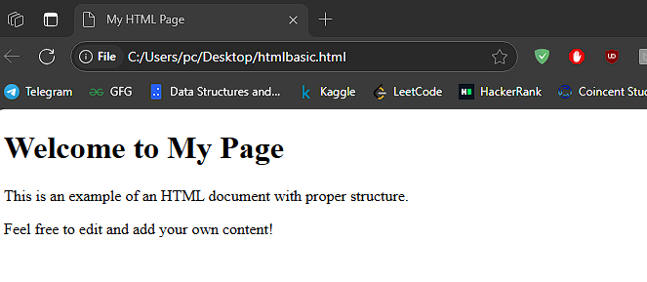
SAMPLE HTML5 DOCUMENT
Code:
<!DOCTYPE html>
<html>
<head>
<title>My HTML Page</title>
</head>
<body>
<h1>Welcome to My Page</h1>
<p>This is an example of an HTML document with proper structure.</p>
<p>Feel free to edit and add your own content!</p>
<!--HTML COMMENT TAG-->
</body>
</html>

Slide 9
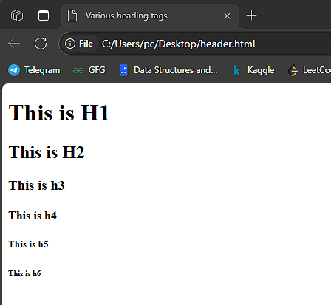
VARIOUS HEADER TAGS
<!DOCTYPE html>
<html>
<head>
<title>Various heading tags</title>
</head>
<body>
<h1>This is H1</h1>
<h2>This is H2</h2>
<h3>This is h3</h3>
<h4>This is h4</h4>
<h5>This is h5</h5>
<h6>This is h6</h6>
</body>
</html>

Slide 10
SOME OTHER IMPORTANT HTML TAGS
Links (<a> tag):
Used to create hyperlinks to navigate between pages or sections.
Example: <a href="https://example.com">Click here</a>
Images (<img> tag):
Used to display images on a webpage.
Example: <img src="image.jpg" alt="Description of Image">
Lists:
Ordered List (<ol> tag): Displays items in a numbered list.
Example: <ol><li>Item 1</li><li>Item 2</li></ol>
Unordered List (<ul> tag): Displays items with bullet points.
Example: <ul><li>Item 1</li><li>Item 2</li></ul>

Slide 11
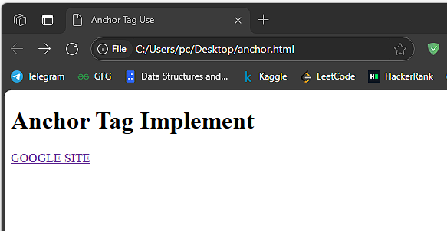
ANCHOR TAG IMPLEMENTATION
<!DOCTYPE html>
<html>
<head>
<title>Anchor Tag Use</title>
</head>
<body>
<h1>Anchor Tag Implement</h1>
<a href="https://www.google.com/">GOOGLE SITE</a>
</body>
</html>

Slide 12
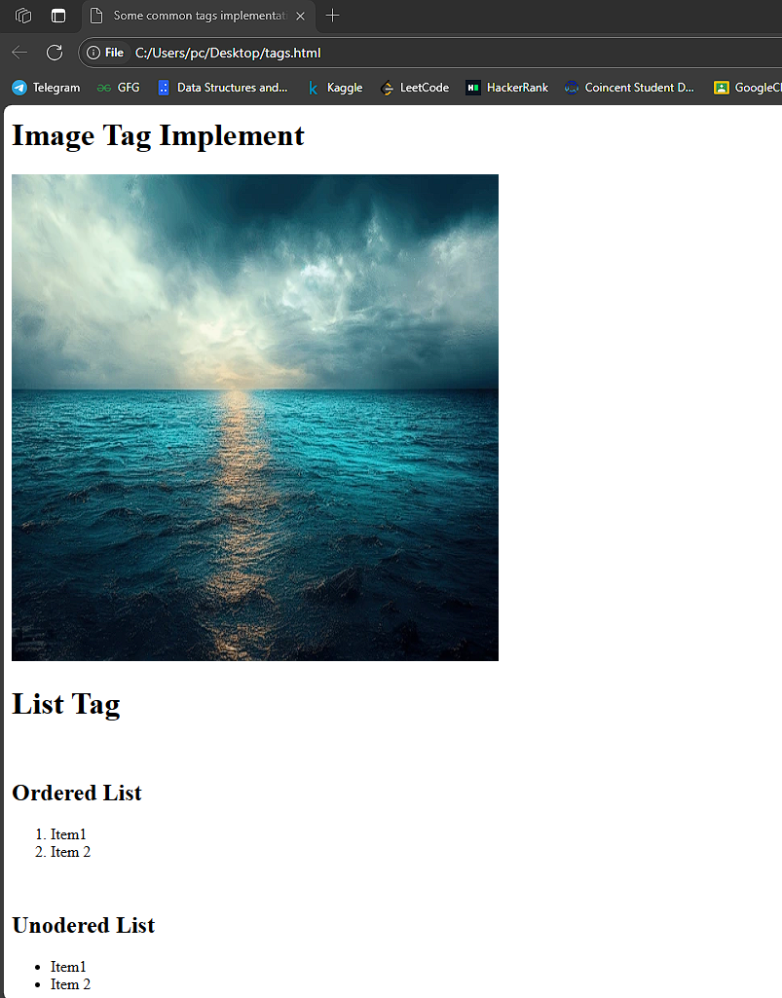
IMAGE TAG & OL AND UL LIST TAGS IMPLEMENTATION
<!DOCTYPE html>
<html>
<head>
<title>Some common tags implementation</title>
</head>
<body>
<h1>Image Tag Implement</h1>
<img src="https://www.shutterstock.com/image-photo/calm-weather-on-sea-ocean-600nw-2212935531.jpg" alt="Random Image" style="width: 500px; height: 500px;">
<br>
<h1>List Tag</h1>
<br>
<h2>Ordered List</h2>
<ol><li>Item1</li><li>Item 2</li></ol>
<br>
<h2>Unodered List</h2>
<ul><li>Item1</li><li>Item 2</li></ol>
<br>
</body>
</html>
Tags Used:
1.<img> tag
2.<br> tag
3.<ol> tag
4.<ul> tag

Slide 13
SOME OTHER IMPORTANT HTML TAGS
Table (<table> tag):
Used to display data in rows and columns.
Example:
<table>
<tr><th>Header 1</th><th>Header 2</th>
</tr><tr><td>Data 1</td><td>Data 2</td></tr>
</table>
Horizontal Line (<hr> tag):
Adds a horizontal line to separate sections.
Example: <hr>
Line Break (<br> tag):
Inserts a single line break in text.
Example: This is<br>new line text.

Slide 14
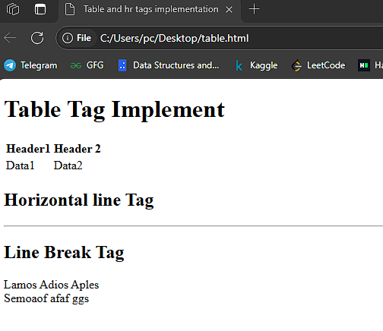
TABLE TAG AND HR TAG IMPLEMENTATION
<!DOCTYPE html>
<html>
<head>
<title>Table and hr tags implementation</title>
</head>
<body>
<h1>Table Tag Implement</h1>
<table>
<tr><th>Header1</th><th>Header 2</th></tr>
<tr><td>Data1</td><td>Data2</td></tr>
</table>
<h2>Horizontal line Tag</h2>
<hr>
<h2>Line Break Tag</h2>
<p>Lamos Adios Aples<br>Semoaof afaf ggs</p>
</body>
</html>

Slide 15

WHAT IS HTML5?
HTML5 is the current or latest version of the HTML trendy, which is used to format and supply content on the World Wide Web.
HTML5 consists of a plethora of latest capabilities that beautify the capability of web pages and apps, making them greater dynamic, efficient, and user-pleasant.

Slide 16
FEATURES OF HTML5
1. Improved Syntax
HTML5 introduces new semantic elements that offer higher structure and meaning to the internet content material. These elements make the HTML code extra readable and accessible each for builders and search engines like google. : Defines a header for a record or segment.
<header> : Defines a container for navigation hyperlinks.
<nav > : Represents a self-contained piece of content material.
<article> : Defines a phase in a record.
<section > : Defines a section in a document
<footer > : Represents a footer for a file or section.
2. Enhanced Multimedia Support
<audio> and <video> tags for media playback
no need for Flash or external plugins
3.Canvas & SVG for Graphics
<canvas> allows drawing graphics & animations using JavaScript
SVG (Scalable Vector Graphics) supports high-quality images without losing clarity.

Slide 17
FEATURES OF HTML5
4.Geolocation API
Allows web apps to detect user location.
Used for location-based services like maps, weather apps, etc.
5.Offline & Storage Features
LocalStorage & SessionStorage: Stores data in the browser.
IndexedDB: Database-like storage for web applications.
Application Cache: Allows offline access to web pages.
6. Responsive Web Design Support
Media Queries allow web pages to adjust to different screen sizes.
Viewport meta tag for better mobile support.
8. Improved Forms & Input Types
New input types: <email>, <date>, <number>, <range>, etc.
New attributes: placeholder, autofocus, required, pattern, etc.
Built-in validation without JavaScript.
9. Web Workers
Enables background processing to run JavaScript tasks in parallel without blocking the UI

Slide 18
ADVANTAGES OF HTML
Easy to use
Loose syntax (although, being too flexible will not comply with standards).
Supported on almost every browser, if not all browsers.
Widely used; established on almost every website, if not all websites.
Very similar to XML syntax, which is increasingly used for data storage.
Free - You need not buy any software.
Easy to learn & code even for novice programmers.

Slide 19
DISADVANTAGES OF HTML
It cannot produce dynamic output alone, since it is a static language
Sometimes, the structuring of HTML documents is hard to grasp
You have to keep up with deprecated tags, and make sure not to use them
Deprecated tags appear because another language that works with HTML has replaced the original work of the tag; thus the other language needs to be learned (most of the time, it is CSS)
Security features offered by HTML are limited

Slide 20
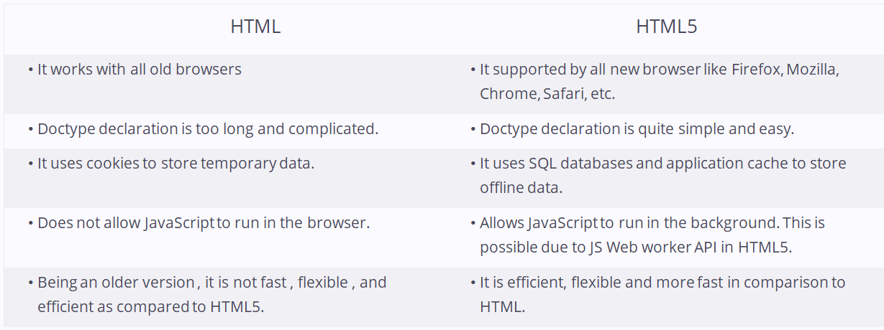
HTML VS HTML5

Slide 21
IMPLEMENTATION
<body>
<video id="video-background" autoplay muted loop>
<source src="background.mp4" type="video/mp4">
Your browser does not support HTML5 video.
</video>
<header>
<h1>Welcome to the PC Games Hub</h1>
<nav>
<ul>
<li><a href="#popular-games">Popular Games</a></li>
<li><a href="#about">About</a></li>
<li><a href="#gallery">Gallery</a></li>
<li><a href="#contact">Contact</a></li>
</ul>
</nav>
</header>
<main>
<section id="popular-games">
<h2>Popular PC Games</h2>
<article>
<h3>1. The Witcher 3: Wild Hunt</h3>
<p>An action role-playing game set in a visually stunning fantasy universe full of meaningful choices and
impactful consequences.</p>
<figure>
<img src="https://upload.wikimedia.org/wikipedia/en/0/0c/Witcher_3_cover_art.jpg" alt="The Witcher 3"
height="200px">
<figcaption>The Witcher 3: Wild Hunt</figcaption>
</figure>
</article>

Slide 22
IMPLEMENTATION
<section id="gallery">
<h2>Game Trailers</h2>
<video controls poster="thumbnail.jpg">
<source src="https://media.w3.org/2010/05/sintel/trailer.mp4" type="video/mp4">
Your browser does not support the video tag.
</video>
</section>
<section id="soundtrack">
<h2>Game Soundtrack</h2>
<br>
<audio controls>
<source src="https://www.soundhelix.com/examples/mp3/SoundHelix-Song-1.mp3" type="audio/mpeg">
Your browser does not support the audio element.
</audio>
</section>
<section id="game-table">
<h2>Game Comparison</h2>
<table>
<tr>
<th>Game</th>
<th>Genre</th>
<th>Release Year</th>
</tr>
<tr>
<td>The Witcher 3</td>
<td>RPG</td>
<td>2015</td>
</tr>
<tr>
<td>Minecraft</td>
<td>Sandbox</td>
<td>2011</td>
</tr>
</table>
</section>
<section id="game-list">
<h2>Top-Rated PC Games</h2>
<ul>
<li>The Witcher 3: Wild Hunt</li>
<li>Minecraft</li>
<li>Cyberpunk 2077</li>
<li>Red Dead Redemption 2</li>
</ul>
</section>

Slide 23
IMPLEMENTATION
<section id="about">
<h2>About Us</h2>
<p>We are passionate about PC gaming and aim to bring you the latest news, reviews, and updates about your favorite games.</p>
</section>
<section id="contact">
<h2>Contact Us</h2>
<form>
<label for="name">Name:</label>
<input type="text" id="name" name="name" required>
<label for="email">Email:</label>
<input type="email" id="email" name="email" required>
<label for="message">Message:</label>
<textarea id="message" name="message" rows="4" required></textarea>
<button type="submit">Submit</button>
</form>
</section>
</main>
<footer>
<p>&copy; 2025 PC Games Hub. All rights reserved.</p>
</footer>

Slide 24
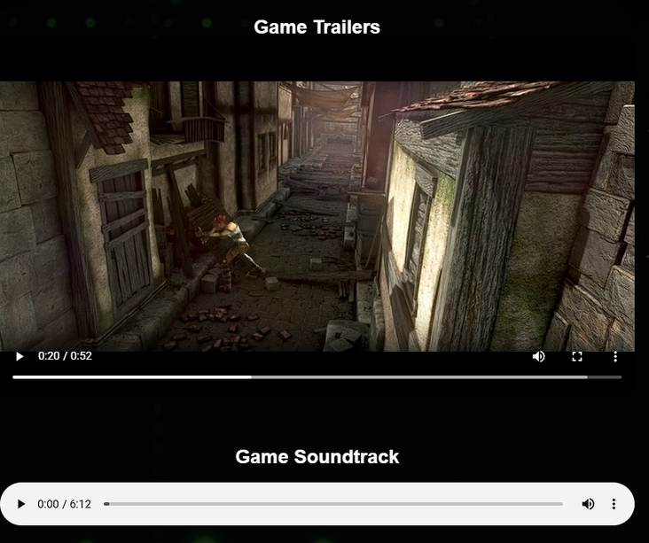
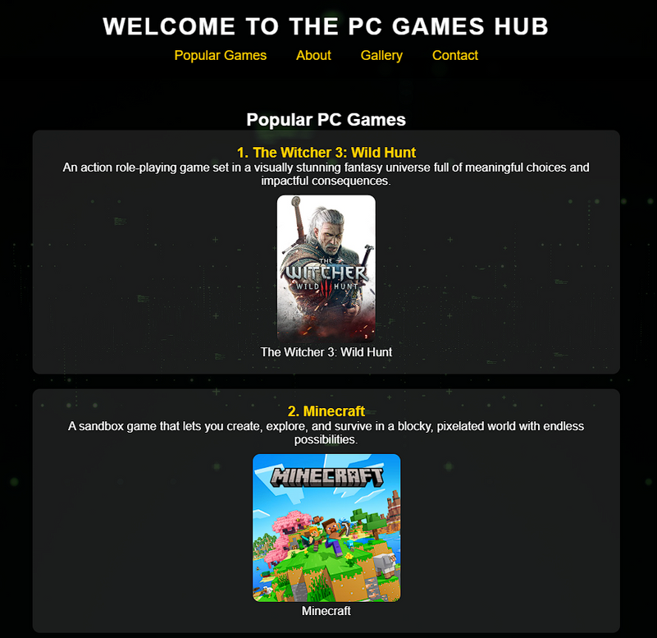

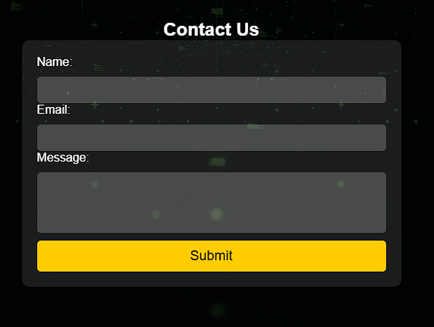
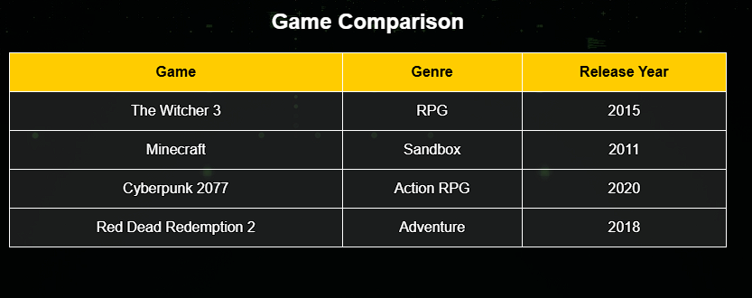

OUTPUT

Slide 25
THANK YOU VERY MUCH!

